Slide 1
Artificial Artificial Artificial Artificial Artificial Artificial Artificial

Slide 2
report report report report report report report
Artificial Intelligence is the ability of a computer programme to think and learn, mirroring the intelligence of humans. While the concept of AI has been around for over 50 years, recent developments have enabled its use at an industrial scale. The research aims to provide an accurate portrayal of the current state of AI and its potential for general public, industry and governments.

Slide 3
Transportation Transportation Transportation Transportation Transportation Transportation Transportation
Artificial intelligence (AI) is becoming more accessible to the public and is being used in a variety of fields, including transportation, healthcare, and the home. AI in transportation includes selfdriving cars and flying vehicles, and AI in healthcare is being used to improve accuracy and efficiency in diagnosing and treating diseases. Home/service robots are becoming more common and are being used for a variety of tasks, such as cleaning and security.

Slide 4
summary summary summary summary summary summary summary
The report highlights the potential of AI in improving healthcare outcomes, but also notes the technical and regulatory challenges that must be addressed to realize its full potential. Key applications for AI in healthcare include clinical decision support, patient monitoring and coaching, automated devices in surgery, and healthcare system management. The report calls for the reduction of obstacles and the development of innovative technologies to make AI a more effective tool in healthcare.

Slide 5
Key Key Key Key Key Key Key
The paper discusses the potential impact of AI technology on society, and specifically on the quality of people's lives in cities. It highlights how AI can help improve healthcare, education, public safety and security. The paper also discusses some of the challenges and potential risks associated with the increasing use of AI technology in these areas.

Slide 6
Policing Policing Policing Policing Policing Policing Policing
The rapid development of artificial intelligence is beginning to have a significant impact on a typical North American city and is affecting a wide range of sectors from healthcare to the economy. However, there are concerns about the technology, from its potential to exacerbate existing inequalities, to its impact on privacy and employment. This report analyzes the current and future state of AI and its implications for urban life.

Slide 7
sums sums sums sums sums sums sums
Artificial intelligence will have a spectrum of effects on jobs, from small amounts of augmentation to complete replacement, as the technology evolves, says a new report from the McKinsey Global Institute. Existing jobs most likely to be lost include those in administration, manufacturing and construction. New jobs are likely to emerge in hardware, software, semiconductor and display fabrication.

Slide 8
advances advances advances advances advances advances advances
AI has caused an explosion in entertainment platforms and sources over the past 15 years. From usergenerated content on social media, to virtual worlds like Second Life, to hardware like the Amazon Kindle, AI has transformed how humans consume entertainment. AI has been used in professional sports to conduct quantitative analysis, and in the arts to explore historical topics. AI has enabled lay users to be creative through platforms such as Words Eye.

Slide 9
Economics" Economics" Economics" Economics" Economics" Economics" Economics"
AI has grown to the point of having an impact on our culture It has impacted the way we think, interact, and go about our daily lives. It has also impacted many disciplines such as healthcare, economics, and religion.

Slide 10
4word 4word 4word 4word 4word 4word 4word
AI has started to deliver real benefits to companies that have adopted the technology, such as Amazon and Google. Investment in AI has tripled over the past three years, to between $20bn and $40bn. AI is being used by retailers, utilities and automakers to improve efficiency and productivity.

Slide 11
Value Value Value Value Value Value Value
The global AI market is set to grow by 175% from its previous level, reaching $2.4bn. AI can deliver real value to companies if used across operations and within core functions.

Slide 12
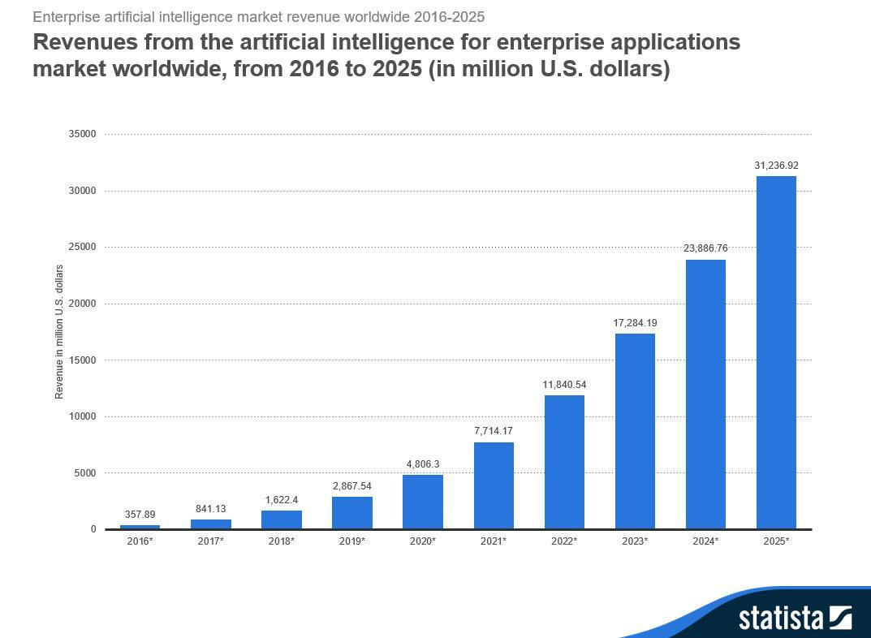

Slide 13
a a a a a a a
As artificial intelligence gets increasingly sophisticated, so do the conversations around how it could be dangerous. We can expect AI to be used in every industry in the future. While AI does not have intentions, it can be dangerous in the wrongs hands. It is important to consider the goals we give AI and ensure they are properly aligned.

Slide 14
need need need need need need need
Artificial intelligence functions include all aspects of perception, learning, knowledge representation, reasoning, planning and decision making. Strong artificial intelligence can adapt to new context, while weak artificial intelligence cannot.

